Slide 1
Introduction to Javascript
Lecture 4

Slide 2
What is JavaScript?
Was designed to add interactivity to HTML pages
Is a scripting language (a scripting language is a lightweight programming language)
JavaScript code is usually embedded directly into HTML pages
JavaScript is an interpreted language (means that scripts execute without preliminary compilation)

Slide 3
What is JavaScript?
JavaScript gives HTML designers a programming tool
JavaScript can put dynamic text into an HTML page
JavaScript can react to events
JavaScript can read and write HTML elements
JavaScript can be used to validate input data
JavaScript can be used to detect the visitor‘s browser
JavaScript can be used to create cookies

Slide 4
Where to Place Scripts?
Three places to define
First: Place it within the head of the HTML document. Scripts here aren't automatically executed when the page loads but can be referred to by other scripts within the document.
Second: Define a script within the body of the HTML document. Scripts here are executed as the page loads.
Third: Define a script within an event handler.
Can also include the src attribute to the script tag
Save script to an external file and include it in the HTML file.
Use the .js extension when saving JavaScript to an external file. <script src="menu.js"> The above would include the JavaScript from the menu.js file.

Slide 5
Where to Place Scripts?
Where to Put the JavaScript
Scripts in the body section will be executed WHILE the page loads.
Scripts in the head section will be executed when CALLED.
Scripts in the head section:
<html> <head> <script type="text/javascript"> some statements </script> </head>
Scripts in the body section:
<html> <head> </head> <body> <script type="text/javascript"> some statements </script> </body>
Scripts in both the body and the head section:
<html> <head> <script type="text/javascript"> some statements </script> </head> <body> <script type="text/javascript"> some statements </script> </body>

Slide 6
Example
Put a JavaScript Into an HTML Page
<html> <body> <script type="text/javascript"> document.write("Hello World!") </script> </body> </html>
The code above will produce this output on an HTML page:
Hello World!
Explanation:
<script type="text/javascript">: Use the <script> tag. Use the type attribute to define the scripting language
document.write("Hello World!"): The JavaScript command for writing some output to a page is document.write
</script>: <script> tag has to be closed.

Slide 7
JavaScript Variable
Variable can be created with or without the var statement
var strname = some value
strname = some value
When variable is declareed within a function, the variable can only be accessed within that function
If variable is declareed outside a function, all the functions on page can access it
The lifetime of these variables starts when they are declared, and ends when the page is closed

Slide 8
JavaScript Popup Boxes
Alert box
User will have to click "OK" to proceed
alert("sometext")
Confirm box
User will have to click either "OK" or "Cancel" to proceed
confirm("sometext")
Prompt box
User will have to click either "OK" or "Cancel" to proceed after entering an input value
prompt("sometext","defaultvalue")

Slide 9
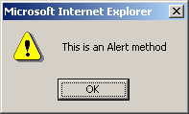
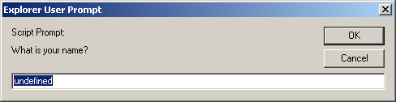
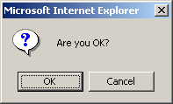
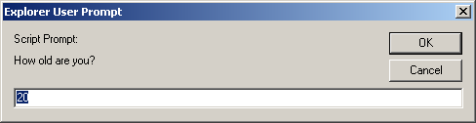
alert(), confirm(), and prompt()
<script type="text/javascript">
alert("This is an Alert method");
confirm("Are you OK?");
prompt("What is your name?");
prompt("How old are you?","20");
</script>

Slide 10
alert() and confirm()
alert("Text to be displayed");
Display a message in a dialog box.
The dialog box will block the browser.
var answer = confirm("Are you sure?");
Display a message in a dialog box with two buttons: "OK" or "Cancel".
confirm() returns true if the user click "OK". Otherwise it returns false.

Slide 11
prompt()
prompt("What is your student id number?");
prompt("What is your name?”, "No name");
Display a message and allow the user to enter a value
The second argument is the "default value" to be displayed in the input textfield.
Without the default value, "undefined" is shown in the input textfield.
If the user click the "OK" button, prompt() returns the value in the input textfield as a string.
If the user click the "Cancel" button, prompt() returns null.

Slide 12
JavaScript Language
Conditional statement
> if, if.. else, switch
Loop
> for loop, while loop
try...catch
throw
All have the same syntax as those found in C and Java.

Slide 13
JavaScript Functions
A JavaScript function contains some code that will be executed only by an event or by a call to that function
To keep the browser from executing a script as soon as the page is loaded, write script as a function
Function can be called from anywhere within the page (or even from other pages if the function is embedded in an external .js file).
Functions can be defined either in <head> or <body> section
As a convention, they are typically defined in the <head> section

Slide 14
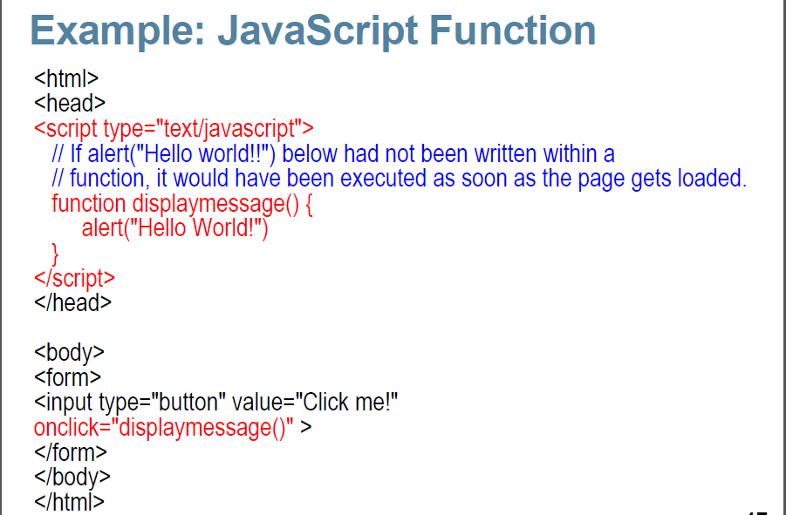

Slide 15
Events & Event Handlers
Every element on a web page has certain events which can trigger invocation of event handlers
Attributes are inserted into HTML tags to define events and event handlers
Examples of events
A mouse click
A web page or an image loading
Mouse hovering over a hot spot on the web page
Selecting an input box in an HTML form
Submitting an HTML form
A keystroke

Slide 16
Events
onabort - Loading of an image is interrupted
onblur - An element loses focus
onchange - The content of a field changes
onclick - Mouse clicks an object
ondblclick - Mouse double-clicks an object
onerror - An error occurs when loading a document or an image
onfocus - An element gets focus
onkeydown - A keyboard key is pressed
onkeypress - A keyboard key is pressed or held down
onkeyup - A keyboard key is released

Slide 17
Events
onload - A page or an image is finished loading
onmousedown - A mouse button is pressed
onmousemove - The mouse is moved
onmouseout - The mouse is moved off an element
onmouseover - The mouse is moved over an element
onmouseup - A mouse button is released
onreset - The reset button is clicked
onresize - A window or frame is resized
onselect - Text is selected
onsubmit - The submit button is clicked
onunload - The user exits the page

Slide 18
onload & onUnload Events
The onload and onUnload events are triggered when the user enters or leaves the page
The onload event is often used to check the visitor‘s browser type and browser version, and load the proper version of the web page based on the Information
Both the onload and onUnload events are also often used to deal with cookies that should be set when a user enters or leaves a page

Slide 19
onFocus, onBlur and onChange
The onFocus, onBlur and onChange events are often used in combination with validation of form fields.
Example: The checkEmail() function will be called whenever the user changes the content of the field:
<input type="text" size="30” id="email“ onchange=“checkEmail() ">;

Slide 20
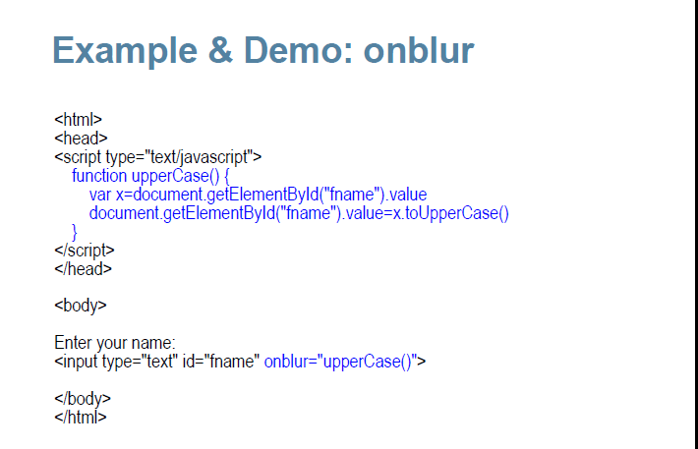

Slide 21
onSubmit
The onSubmit event is used to validate all form fields before submitting it.
Example: The checkForm() function will be called when the user clicks the submit button in the form. If the field values are not accepted, the submit should be canceled.
The function checkForm() returns either true or false. If it returns true the form will be submitted, otherwise the submit will be cancelled:
<form method="post" action="xxx.html“ onsubmit="return checkForm()">

Slide 22
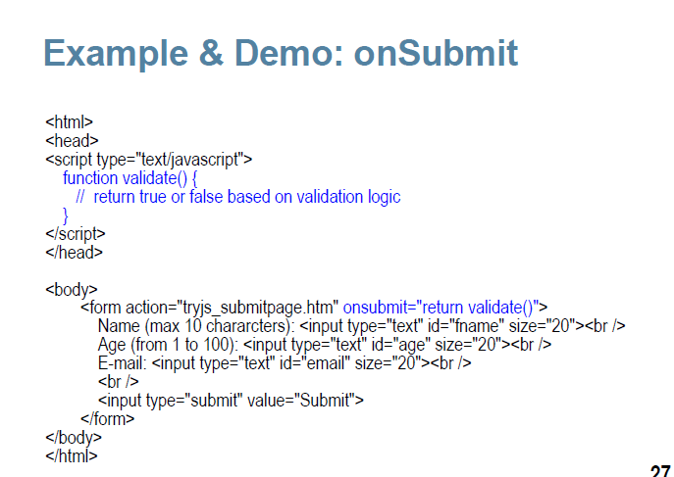

Slide 23
onMouseOver and onMouseOut
onMouseOver and onMouseOut are often used to create "animated" buttons.
Below is an example of an onMouseOver event. An alert box appears when an onMouseOver event is detected:
<a href="http://www.w3schools.com”
onmouseover="alert('An onMouseOver event');return false">
<img src="w3schools.gif" width="100" height="30">
</a>

Slide 24
JavaScript Object
JavaScript is an Object Oriented Programming (OOP) language.It supports programming with objects.
Objects are a way of organizing the variables.
The different screen elements such as Web pages, forms, text boxes, images, and buttons are treated as objects.
Objects are just data, with properties and methods
Properties are values associated with objects.
Methods are actions that objects can perform.

Slide 25
Objects - Properties and Methods
Every object has its own properties and methods.
Properties define the characteristics of an object.
Examples: color, length, name, height, width
Methods are the actions that the object can perform or that can be performed on the object.
Examples: alert, confirm, write, open, close

Slide 26
Naming Objects
Objects are organized in a hierarchy.
To refer to an object use :
objectName
To refer to a property of an object use: objectName.propertyName
To refer to a method of an object use: objectName.methodName()
JavaScript Built-in objects
String
Date
Array
Boolean
Math

Slide 27
JavaScript Built-in Objects
String
Date
Array
Boolean
Math

Slide 28
Create Custom Objects
With JavaScript you can define and create your own objects. There are 2 different ways to create a new object:
Define and create a direct instance of an object.
Use a function to define an object, then create new object instances.

Slide 29
Option 1: Creating a Direct Instance of a JavaScript Object
By invoking the built-in constructor for the Object class personObj=new Object(); // Initially empty with no properties or methods
Add properties to it
personObj.firstname="John“;
personObj.age=50;
Add a function to the personObj
personObj.tellYourage=function(){
alert(“This age is ” + this.age);
}/
/ You can call then tellYourage function as following
personObj.tellYourage();

Slide 30
Option 2: Creating a template of a JavaScript Object
The template defines the structure of a JavaScript object in the form of a function.
You can think of the template as a constructor
function Person(firstname,lastname,age,eyecolor) {
this.firstname=firstname;
this.lastname=lastname;
this.age=age;
this.tellYourage=function(){
alert(“This age is ” + this.age);
}
}

Slide 31
HTML DOM Objects
The HTML DOM defines a standard set of objects for HTML, and a standard way to access and manipulate HTML documents.
All HTML elements, along with their containing text and attributes, can be accessed through the DOM.
The contents can be modified or deleted, and new elements can be created.
The HTML DOM is platform and language independent
It can be used by any programming language like Java, JavaScript, and VBScript

Slide 32
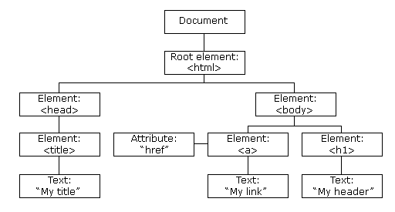
The HTML DOM Tree

Slide 33
Document Object: Write text to the output
<html>
<body>
<script type="text/javascript">
document.write("Hello World!")
</script>
</body>
</html>

Slide 34
Document Object: Write text with Formatting to the output
<html>
<body>
<script type="text/javascript">
document.write("<h1>Hello World!</h1>")
</script>
</body>
</html>

Slide 35
Document Object: Use getElementById()
<html>
<head>
<script type="text/javascript">
function getElement() {
var x=document.getElementById("myHeader")
alert("I am a " + x.tagName + " element“) }
</script> </head>
<body>
<h1 id="myHeader" onclick="getElement()">Click to see what element I am!</h1>
</body>
</html>

Slide 36
Document Object: Use getElementsByName()
<html>
<head>
<script type="text/javascript">
function getElements() {
var x=document.getElementsByName("myInput")[0].value
Alert(“value of first element “+ x)
}
</script> </head>
<body>
<input name="myInput" type="text" size="20"><br />
<input name="myInput" type="text" size="20"><br />
<input name="myInput" type="text" size="20"><br /><br />
<input type="button" onclick="getElements()" value=“value of first input">
</body>
</html>

Slide 37
Document Object: Return the innerHTML of the first anchor in a document
<html>
<body>
<a name="first">First anchor</a><br />
<a name="second">Second anchor</a><br />
<a name="third">Third anchor</a><br />
<br />
InnerHTML of the first anchor in this document:
<script type="text/javascript">
document.write(document.anchors[0].innerHTML)
</script>
</body>
</html>

Slide 38
Document Object: Access an item in a collection
<html>
<body>
<form id="Form1" name="Form1">
Your name: <input type="text">
</form>
<form id="Form2" name="Form2">
Your car: <input type="text">
</form>
<p> To access an item in a collection you can either use the number or the name of the item:</p>
<script type="text/javascript">
document.write("<p>The first form's name is: " + document.forms[0].name + </p>")
document.write("<p>The first form's name is: " + document.getElementById("Form1").name + "</p>")
</script> </body>
</html>

Slide 39
<html> <head> <script> function validateForm() { var x=document.forms["myForm"]["fname"].value; if (x==null || x=="") { alert("First name must be filled out"); return false; } } </script> </head> <body> <form name="myForm" action="demo_form.asp" onsubmit="return validateForm()" method="post"> First name: <input type="text" name="fname"> <input type="submit" value="Submit"> </form> </body> </html>

Slide 40
JavaScript HTML DOM - Changing CSS
The HTML DOM allows JavaScript to change the style of HTML elements.
Changing HTML Style
document.getElementById(id).style.property=new style
<html> <body> <p id="p2">Hello World!</p> <script> document.getElementById("p2").style.color="blue"; </script> <p>The paragraph above was changed by a script.</p> </body>
</html>

Slide 41
JavaScript HTML DOM Events
HTML DOM allows JavaScript to react to HTML events
<html>
<head>
<script>
function changetext(id){
id.innerHTML="Ooops!";
}
</script>
</head>
<body>
<h1 onclick="changetext(this)">Click on this text!</h1>
</body>
</html>

